Slide 1
Introduction to Machine Learning
Kyli McKay-Bishop
Notes:
Thank you for being here tonight and letting me share this topic with you.
Let me give you the road map for tonight. I hope this helps you frame our discussion.
First, we are going to define Artificial Intelligence and Machine Learning
We will discuss the different types of machine learning algorithms. Tonight’s discussion will primarily focus on one type of task, supervised learning.
We will use a canonical example, polynomial regression, to illustrate ideas like overfitting and underfitting, model capacity, and generalizability.
We will discuss neuron and their loose ties to the neurons in our mind.
We will see how neurons can be combined into layers in neural nets and how to train a neural net.
Finally, and maybe this is giving it away, we will see how deep learning is a network with many of these layers.
Please, feel free to ask questions as we go.
Before we get started I want to get a sense of the audience and familiarity with this topic, that will help direct tonight’s discussion.
I have heard of AI, Machine Learning, and deep learning before, but couldn’t give you a formal definition.
I could give you a formal definition
I have programmed a machine learning algorithm before.
I am an expert, I’ve designed and developed several algorithms

Slide 2
Artificial Intelligence
Machine Learning
Deep Learning
Notes:
As just a quick overview this is how each of these field relate to each other. Mach Learning is a subfield of artificial intelligence and deep learning is a subfield of machine learning. There was not time to explore everything tonight but there is so much to learn in each of these field and I encourage you get out there and explore.

Slide 3
Artificial Intelligence
“The theory and development of computer systems able to perform tasks that normally require human intelligence, such as visual perception, speech recognition, decision-making, and translation between languages.”
1. Google Search Definition
Notes:
The term artificial intelligence was coined in 1956 by John McCarthy when he was organizing the Dartmouth Summer Research Project on Artificial Intelligence. The goal of the Summer Research Project was to clarify and develop ideas around thinking machines. He selected the term artificial intelligence for it’s neutrality. He did not want to focus on or over emphasize any of the specific fields used to describe the field at the time; including cybernetics, automata theory, and complex information processing.
For those of you not familiar John McCarthy, you can think him for Garbage Collection and Time Sharing. Time sharing may be more familiar to you under the aliases servers and cloud computing.
<Read Definition>
As many of you surmised from the name, the field of Artificial Intelligence is our attempt to build human intelligence. If successful, it is likely that AI will exceed human intelligence; be super-intelligent. In fact, we already have seen machines that exceed human capabilities. One example is DeepMind’s AlphaGo which is “arguably the world strongest go player of all time”.
AlphaGo fits this definition of AI, however it does not fit the definition of “strong” which “is the intelligence of a machine that has the capacity to understand or learn any intellectual task that a human being can”
AlphGo can play the game Go very well, but it will fail at tasks which are quite simple for humans like face recognition or reading handwritten letters, although there are other machines using different algorithms and trained using different data that can achieve these tasks with better than human performance.
Lately, people have been using the term Artificial General Intelligence to describe a machine that can be a general learner/intellect like humans.
If we are going to build intelligent machines we might expect that they would be able to learn. After all that is how humans become more intelligent. One of the major fields of AI is, Machine Learning, and we will define that next.
Tonight our discussion will focus on how machines learn or gain their own knowledge. Another technique for solving the problem of artificial intelligence is the knowledge based approach. Where the machine is given a large pre-programmed knowledge base in a formal language that it can then reason with using logical inference rules. This form of AI has been less successful than the machine learning approach. This is partly due to the difficulty of formalizing human knowledge. Much of what we know does not fit clear rules.
For example, lets say I am building a machine that identifies images of different animals, so a computer vision task. With the knowledge based approach I would attempt to provide the machine with all the information necessary to differentiate different animals. In this hypothetical situation, I am currently working on the knowledge of birds. One of the features I might consider is flying; the rule might be ”Birds Fly”. However, penguins are birds that don’t fly. And some insects and bats fly and are not birds. You can see how explicitly programming my knowledge of the Animal Kingdom could be difficult.

Slide 4
Machine Learning
“…a set of methods that can automatically detect patterns in data, and then use the uncovered patterns to predict future data, or to perform other kinds of decision making under uncertainty…” ¹
1. Machine Learning A Probabilistic Perspective Kevin P. Murphy
Notes:
Instead of having to preprogram all of a machines knowledge, we would like to build machines that learn or obtain their own knowledge instead of requiring a human to program the knowledge explicitly. This is the study of Machine Learning; we are going to ”show” the computer lots of examples or data, and have it learn what to do when faced with similar data in the future.
This seems a little abstract now, but we will go through an example of just how this might be achieved. Let us first define the three types of machine learning popular today.

Slide 5
Supervised
LION
Input (x) | Output (y)
0 | 4.41377431
0.2 | 4.71816215
0.4 | 5.11207394
0.6 | 5.87469413
0.8 | 6.41883521
1 | 6.79750539
1.2 | 7.68607383
1.4 | 8.30457583
1.6 | 9.03665808
1.8 | 9.61995057
… | …
TIGER
SLOTH
Notes:
In the standard development pipeline, similar to the knowledge based approach for machine learning, the developer programs the algorithm or rules to result in the correct output given the input. In machine learning we are going to provide the machine with the input and the output and the machine will generate the algorithm or rule necessary to generate that output given the input. When the machine is given both the input and the output this is called supervised learning.
Examples:
Classification: In classification the algorithm is given the input data, in this case images, and the correct label or classification and is expected to learn how to correctly label the images.
Regression: In regression the machine is given the input data, in this case the input values called x and the output y, the machine is expected to learn the function f(x) that maps x to y. In regression the output is not a single label like in classification but instead a real valued output (it can be scalar or vector).

Slide 6
Unsupervised
Notes:
Next, we have unsupervised learning, in the scenario the data the machine is given does not include the correct answer. In this case the computer might only be given the images and expected to learn a useful pattern from the images. An example of this is clustering where the ML algorithm is expected to group similar items together.
For example, we now have several instance of lions and tigers and sloths. The clustering algorithm could group lions together here, tigers together here, and sloths together here. The algorithm won’t know that they are lions, tigers, and sloths, it won’t label the images like the supervised algorithm, but it will recognize similar ”things” and group them together.

Slide 7
Reinforcement Learning
https://medium.com/machine-learning-for-humans/reinforcement-learning-6eacf258b265
Notes:
Finally we have reinforcement learning in which the machine agent is allowed to explore and interact with its environment. The agent will make choices based on its environment, if the agent makes a good choice it will be rewarded and if it makes a poor choice it will be be punished (loose some of its reward). You can think of it as a counter, do something good plus points, do something bad minus points and the goal of the agent is so maximize that counter.
This is how Alpha GO learned to play GO.
Tonight we are going to focus on a supervised learning task to understand explore the field of machine learning. Recall from two slides ago that in a supervised learning task the algorithm is given the input data and the correct answer and must learn how to get from the input data to the correct answer. How is this accomplished?

Slide 8
Supervised ML Task
Data – input and output values
Model – we will decide the model and the ML algorithm will be trained to learn the model parameters
Loss Function – a measure of how good our model is; usually measure the difference between the true value and the value predicted by our model
4. Training – Depends on model/task
Notes:
All supervised machine learning tasks will require four things. The data as we’ve already discussed. A model, which is a loos framework for how the task will be completed. I want to emphasize the loose here, this is not an explicit instruction set like you would see in a standard programming. We are going to provide the model and then require the algorithm to learn the model parameters so that the model will successfully map from the inputs to the outputs. To determine how well our algorithm is doing we will use a loss function which provides a measure between the values predicted by the model and the true values. Finally, we need a way to train our model. The training is how our algorithm will actually learn the correct parameters for our model.
Lets set up our task.

Slide 9
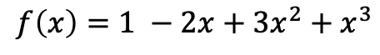
Example: Polynomial Regression
https://github.com/kylinmb/IntroductionToMachineLearning
$$f\left(x\right)=1 −2x+3x^{2}+x^{3}$$
Notes:
Actually first, let me tell you about where you can find these slides and code. I created a github repository that you can clone. The README has instructions for how to download and get the code started. All the code is in Jupyter notebook and written in Python, if you are interested in Machine Learning or Data Science, Phyton is a great language to learn (show notebooks here). Kaggle has an introduction to Python for programmers and Python has an entire page of resources for beginners. You can find links to these resources at the end of these slides.
Also, a quick note about Kaggle – If this topic interests you a highly recommend checking out Kaggle; Kaggle has lots of information about machine learning and data science and is a great place to test your skills with the Kaggle challenges.
Our task tonight is we are given values of x and t = f(x). The t values are generated using this equation. F(x) is a third degree polynomial. Our task is to recover the mapping from x to t; so f(x) using the data. Normally, you won’t be given the equation that generates the data only the data, however it will be useful to have for illustrative purposes.
I added noise to our data, to make it more realistic, so the final data looks like this. You can see that it has a roughly similar shape, but is spikey now.

Slide 10
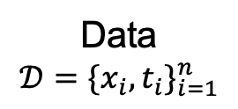

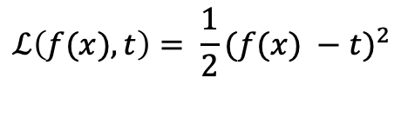
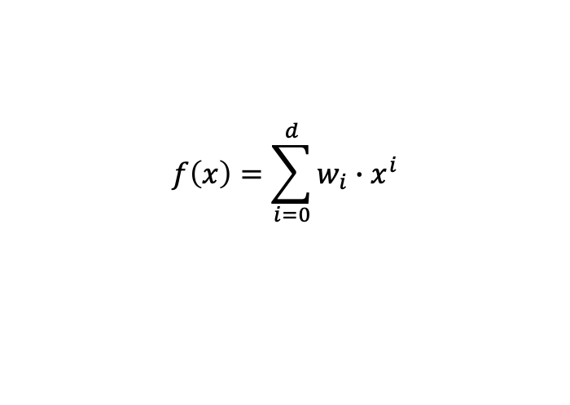
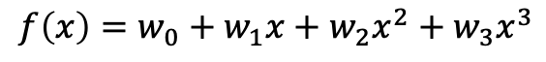

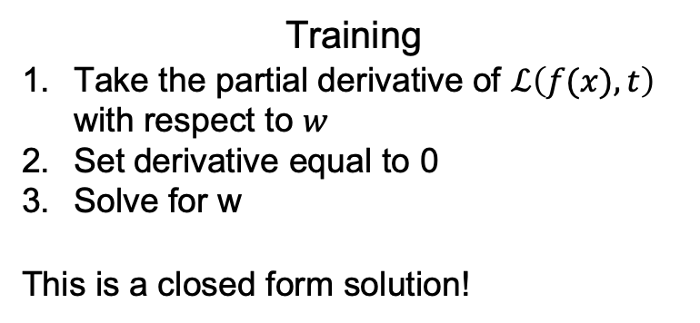
Example: Polynomial Regression
Data
$$𝒟=\{x_{i}, t_{i}\}_{i=1}^{n}$$
Loss Function
$$ℒ\left(f(x), t\right)= \frac{1}{2}{(f(x) −t)}^{2}$$
Model (multiple choices)
$$f\left(x\right)=w_{0}+w_{1}x$$
Training
Take the partial derivative of $ℒ\left(f(x), t\right)$ with respect to $w$
Set derivative equal to 0
Solve for w
This is a closed form solution!
$$f\left(x\right)=w_{0}+w_{1}x+w_{2}x^{2}$$
$$f\left(x\right)=w_{0}+w_{1}x+w_{2}x^{2}+w_{3}x^{3}$$
$$f\left(x\right)=\sum_{i=0}^{d}{w_{i}∙x^{i}}$$
https://www.cs.toronto.edu/~rgrosse/courses/csc321_2018/readings/L02%20Linear%20Regression.pdf
Notes:
Here are the components of our task. We have the data which is just the set of x and t values. For our model we have multiple options, we can fit our data using a linear model, a quadratic model, or more generally any degree d polynomial. The degree of our polynomial is what is called a hyperparamter, it is a model parameters that is set before training begins. The w’s in our model are called the weights. These are the model parameters that the algorithm is expected to learn. We define the square error loss, if the value f(x) predicted by our model is quite different from the target this will be large and this will be small if they are close. We want out predictions to be close to the true value so we will try and minimize this loss function in training. Finally we have training. Polynomial regression is nice because it can actually be solved in closed form and trained in a single step. When we look at neural networks later on we will see a case of where training takes place iteratively.
How does this training work? We need to find the values of w in f(x) that minimize the loss function. We can do this by taking the partial derivative of the loss function with respect to w, setting it equal to zero and solving for w. This training algorithm can be a little tricky if calculus isn’t something you’ve done recently. Without going through the calculations lets get a sense of how this works. Know that the minimum of a function has the nice property that the derivative of the function at the minimum is 0. So if we solve for w when the derivative of the loss function is set to 0 we are solving for the values of w that minimize the loss function.
If you didn’t follow this completely do not worry, you can still make sense of the rest of tonight's discussion. What is important is recognizing that given the data and any of these models determine the values of w that will result in the best predictor f(x).
Not illustrated here, but valuable to know is that this can be solved efficiently using linear algebra.
If you would like to read more and step by step guide through the training calculations you can follow this link, the link goes through linear regression which is just a specific case of polynomial regression where the degree is one.

Slide 11
Example: Polynomial Regression

Slide 12

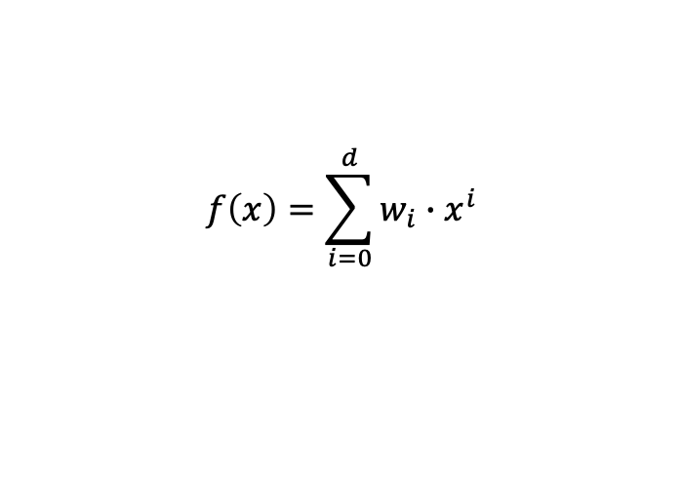
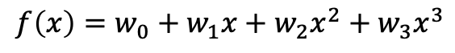

Example: Polynomial Regression
Model (multiple choices)
$$f\left(x\right)=w_{0}+w_{1}x$$
$$f\left(x\right)=w_{0}+w_{1}x+w_{2}x^{2}$$
$$f\left(x\right)=w_{0}+w_{1}x+w_{2}x^{2}+w_{3}x^{3}$$
$$f\left(x\right)=\sum_{i=0}^{d}{w_{i}∙x^{i}}$$
Notes:
I want to define a few more terms before we look at the code and finish solving the regression problem.
Recall that the goal of our machine learning algorithm is to find useful patterns in data and apply them to future, unseen, problems. We call this generalizable or generalizability. To determine if our model generalizes well we will partition our dataset into training and test datasets. We will train our model on the training dataset and evaluate how generalizable our model is on the test dataset i.e. does it perform well on the unseen test data.
Generalizability is closely related to another concept called overfitting.
When a model is overfit that means it has learned the mapping for the training data well and has a low training loss. However, the same model performs poorly on the test data.
If our model performs poorly on both the training and test data, the model is underfitting. Both the training and test loss are high.
Model capacity refers to the range or type of functions a model can approximate. Let’s look at the models we defined on the previous slide again. These are listed by increasing model capacity. The linear function can only represent linear functions whereas the quadratic function can represent both quadratic and linear if w2 is 0 and so on for the quadratic.
We can view overfitting and underfitting through the lens model capacity. When the model capacity is too low we tend to underfit and when it is to high we overfit. Lets illustrate this.
In this graph we have the Degree of the Polynomial along the x axis and the square error along the y axis. Recall that our data was generated from a third degree polynomial. Here in the lower degree we see that we are underfitting, the training and test error are both high. We can not correctly model the third degree polynomial with polynomials of lower degree. As we move right into the 3rd and 4th degree polynomials we see that both the training and test error are low. This means the model capacity is right for our task. Farther left we see that testing error shoot up as the training error decreases. Now our model is learning all the variability in the training data but is not generalizing to the test data. This happens when our model capacity is too large.
Lets look at the training data for each of these scenarios.

Slide 13
Example: Polynomial Regression
Training Error: 0.078
Test Error: 0.058
Notes:
Here is the linear fit, to our data, the blue line is the function learned by our data algorithm and the red line is our original training data. The fit doesn’t look that great and is not capturing the curve of our data. You will also will notice that both the training error and test error are ”high” at least when compared with a fit using the correct degree polynomial that we will see shortly, in this case we are underfitting our data.

Slide 14
Example: Polynomial Regression
Training Error: 0.036
Test Error: 0.106
Notes:
This is a tenth degree polynomial fit to our data. Notice that the blue line now appears to even be modeling the noise in our data and not just the general shape. You can also see that the training error is quite a bit smaller than the test error. This is an overfit.
We can think of this in terms of goldilocks and the three bears, the first model capacity is not enough (too cold), the second model capacity is too much (too hot), and finally we have just right…

Slide 15
Example: Polynomial Regression
Training Error: 0.047
Test Error: 0.037
Notes:
Here we have modeled the data with a third degree polynomial we see that the line now has the correct shape and is no longer modeling the noise in our data. The training and test error are similar and “small”
OK, you guys read to talk about neural nets?

Slide 16
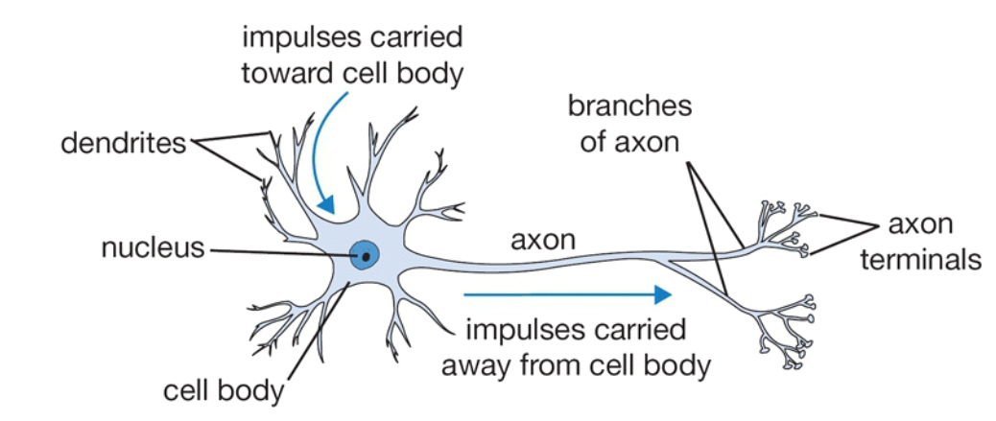
Neurons
http://cs231n.github.io/neural-networks-1/
Notes:
The artificial neuron we will soon see has very, very loose ties to the neurons in our brains. Many people think that the parallels between the two should no longer be made, because the artificial neurons are designed and implemented from an engineering perspective these days and don’t related to the biological neurons. I think that the parallels can be a useful tool to get started.
The basic computation of the human brain is the neuron.
There are 86 billion neurons in the human nervous system.
These neurons are connected by 10^14 – 10^15 synapses
Each neuron receives input at the dendrites and produces output along the axon
The input at the dendrites are combined at the cell body; if they exceed a threshold the axon will fire

Slide 17
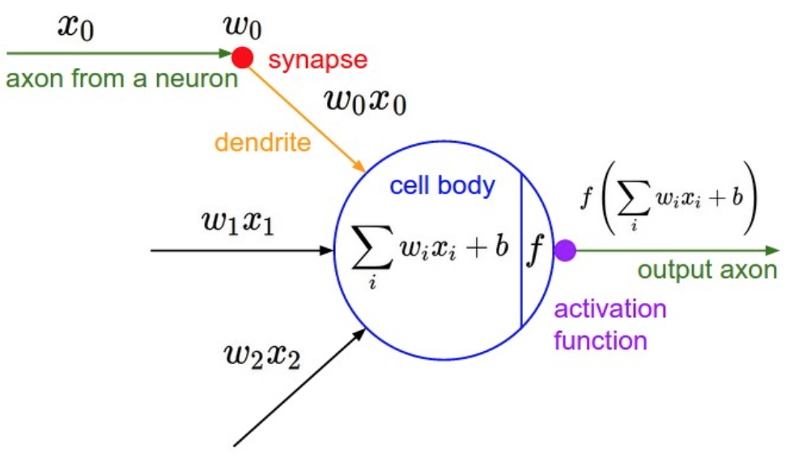
Computational Model of Neuron
http://cs231n.github.io/neural-networks-1/
Notes:
In the computational model we have the signal coming from the axon of another neuron (x) which interact multiplicatively with the dendrites of the other neuron, where the synaptic strength is defined by w
Remember for a moment our original model, x and w should be familiar. Just like they were the input and model parameters in the original they are the weights and inputs in this model.
Each of the dendrites carries its signal to the cell body where they get summed.
The summation is then fed to an activation function which simulates the firing.

Slide 18
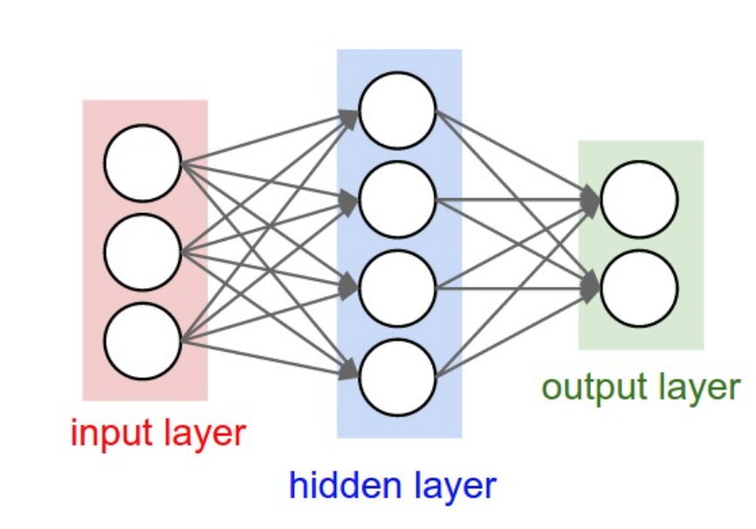
Artificial Neural Networks
http://cs231n.github.io/neural-networks-1/
Notes:
We use combinations of these neurons within layers to build what are called neural networks. This is an example of a fully connected network. Each node/neuron of each layer is connected to every neuron/node in the next layer. There are different types of neural networks depending on the task you are trying to achieve.
What do you think the model capacity is for a neural network? Large but it does depend on the number of hidden layers.
Let revisit our task using a neural networks. This will give us the opportunity to discuss how these are trained.

Slide 19
Example: Polynomial Regression
Data
$$𝒟=\{x_{i}, t_{i}\}_{i=1}^{n}$$
Loss Function
$$ℒ\left(f(x), t\right)= \frac{1}{2}{(f(x) −t)}^{2}$$
Model
Training
Stochastic Gradient Descent and Backpropagation
Notes:
Our data and our loss function are the same. But our model and our training are different.
With neural networks there is not a closed form solution. Instead we will use an iterative process.

Slide 20
Stochastic Gradient Descent
https://wallup.net/landscape-nature-mountain-river-valley/
Notes:
Think of the function as a mountainous region. For polynomial regression we were able to do the closed form solution and essentially what it told us is that right here in the valley floor is the minimum.
For the neural network we won’t be able to get to the minimum in a single step. Instead we are going to take little steps and see if we get closer to the minimum. The good news is we can still use the partial derivative (in this case we are calling it the gradient, which just means derivative for multi-dimensions), this will tell use what direction we need to move to minimize. The gradient will always have us take the path of steepest descent. Consider standing at the top of a hill you can step of a cliff or take switch backs to get to a point below you, gradient descent would have you step off the cliff.
We will start with the weights set to random variables and then each iteration we are going to take a step closer to the weights that minimize the loss function. The step size is called the learning rate and it is one of the hyperparameters of our model.
Backpropagation is a way of propagating the gradients up the neural net. For example if we come back to this figure – we will calculate the gradients for these nodes and using backpropagation which is an application of the chain rule we will be able to update the weights of the nodes here.

Slide 21
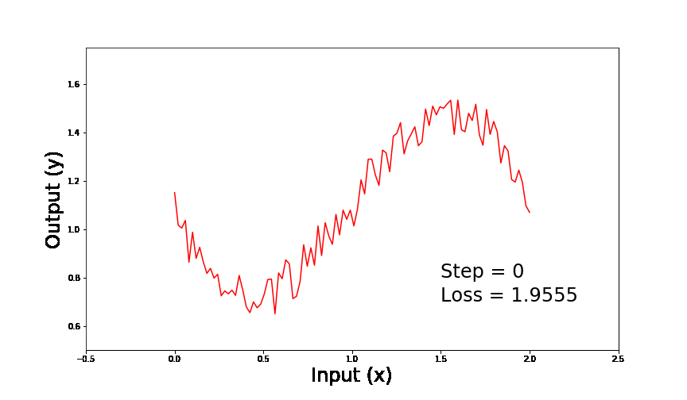
Example: Polynomial Regression
Training Error: 0.018
Test Error: 0.033
Notes:
I built a simple neural network in the IntroToMLNN notebook that has a single hidden layer, much like the figure we’ve seen.
I built the model using Pytorch which is a ML library.
If you are just getting in to ML I highly suggest starting with Pytorch.
I found it easier to learn the TensorFlow, and there is a lot of support for it on the wep.
In the gif we are watching the model train.

Slide 22
Deep Learning
https://becominghuman.ai/deep-learning-made-easy-with-deep-cognition-403fbe445351
Notes:
Finally, deep learning, a neural network with a lot of layers, or deep architecture. This increase the model capacity significantly and so the number of function we can learn is significant.

Slide 23
Resources
Python
https://www.kaggle.com/
https://wiki.python.org/moin/BeginnersGuide
Machine Learning (Websites)
https://www.cs.toronto.edu/~rgrosse/courses/csc321_2018/readings/L02%20Linear%20Regression.pdf
http://cs231n.github.io/
https://www.kaggle.com/
Machine Learning (Books)
http://www.deeplearningbook.org/
https://www.amazon.com/Architects-Intelligence-truth-people-building-ebook/dp/B07H8L8T2J
Tonight’s Slides and Code
https://github.com/kylinmb/IntroductionToMachineLearning
Libraries
https://pytorch.org/
https://numpy.org/
https://matplotlib.org/

